Slide 1
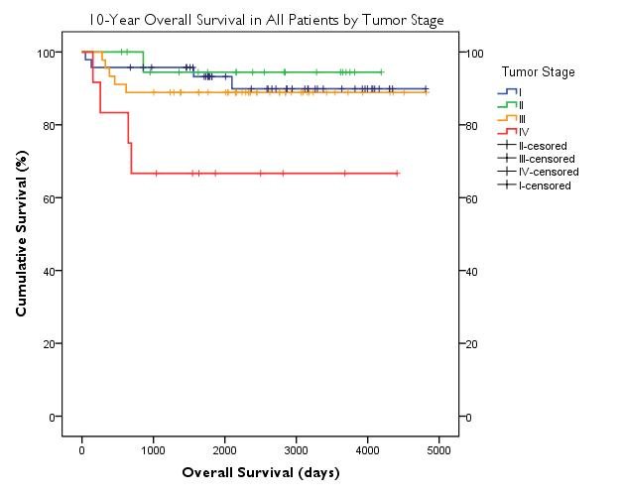
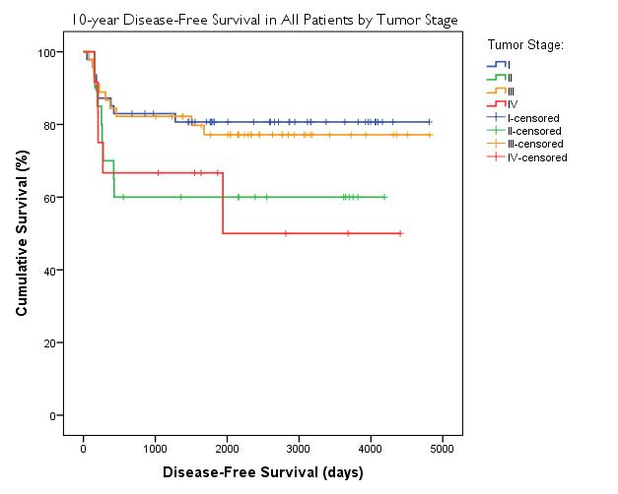
Supplemental Data
Notes:
Put in Supplemental Data

