Slide 1
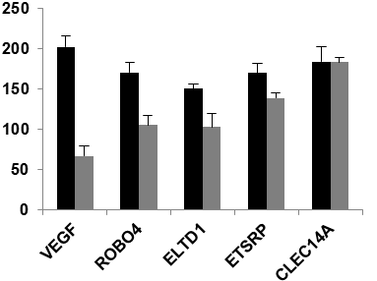
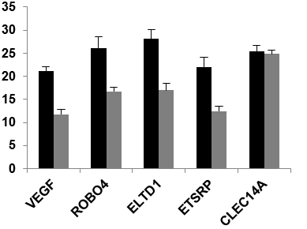
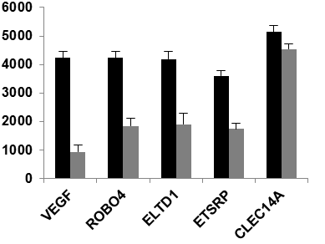
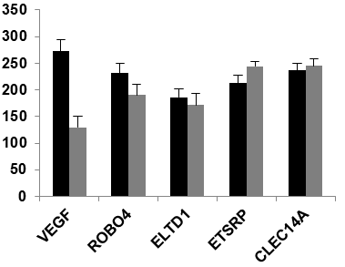
A
Control
Morpholino
Control
Morpholino
VEGFA
48 hpf
ETSRP
48 hpf
ROBO4
48 hpf
48 hpf
CLEC14
48 hpf
ELTD1
Control
B
Morpholino
***
**
***
***
**
**
Number of segments
Average vessel length / pixels
***
***
***
**
***
***
**
**
*
Total vessel length / pixels
Number of junctions
**
***
***
***
***
Number of end points
% connected ISVs

